Slide 1
Trending Down Youth At-Risk Behaviors on a WSCC Diet
Joshua Grant
Coordinator of Physical Education/Physical Activity/Health Education and Driver Education WVDE-Office of Secondary Learning

Slide 2
History
Office of Healthy Schools
History
CDC funded from 1992-2013
Followed the Coordinated School Health model/now WSCC model
Merged with WVDHHR to develop the Coordinated School-Public Health model

Slide 3
The WV Stats….
WV is usually ranked the top three most OBESE states in the nation depending on what survey and data you use.
WV leading the nation in teen smoking rates.
WV leads the nation in teen birth rates.
WV ranked as leading nation in opioid use and over-dose deaths.

Slide 4
Coordinated School-Public Health Components

Slide 5
School Wellness
Coordinated School Public Health
Nutrition Education
Nutrition Guidelines
Physical Activity
Other School Based Activities
Health Education
Physical Education
Nutrition Services
Health Services
Counseling, Psych. & Social Services
School Environment
Parent/Community Involvement
Staff Wellness
Notes:
My position was created with the realization that there were many similarities between school wellness and coordinated school public health. And wouldn’t be nice if we could connect and even combine efforts and resources that had a common goal. As you can see these categories go hand-in-hand.

Slide 6
…And each program/model supported the other inclusive of the integration of public health for a while.

Slide 7
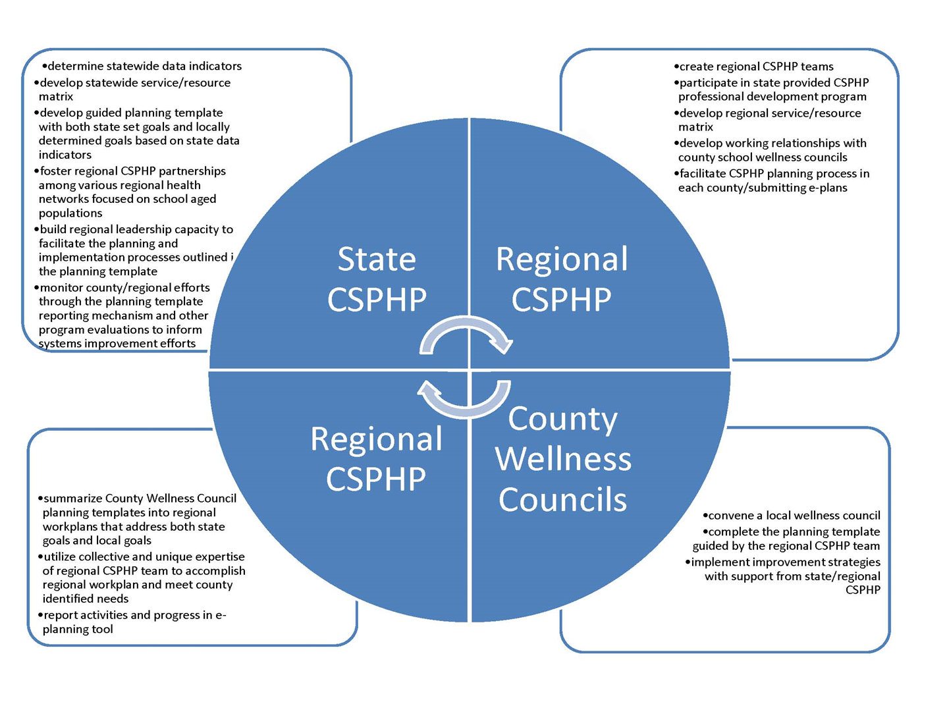

Slide 8
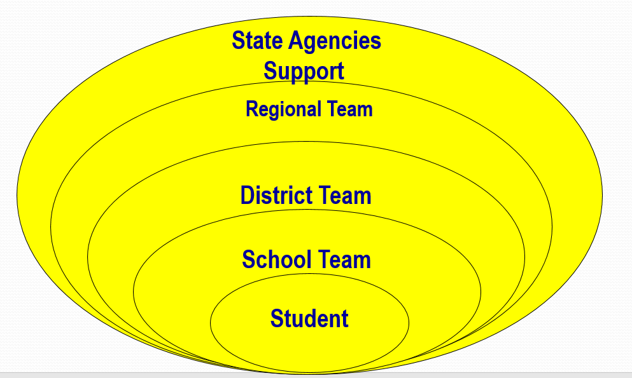

Slide 9
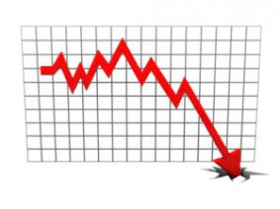
Trending Down…

Slide 10
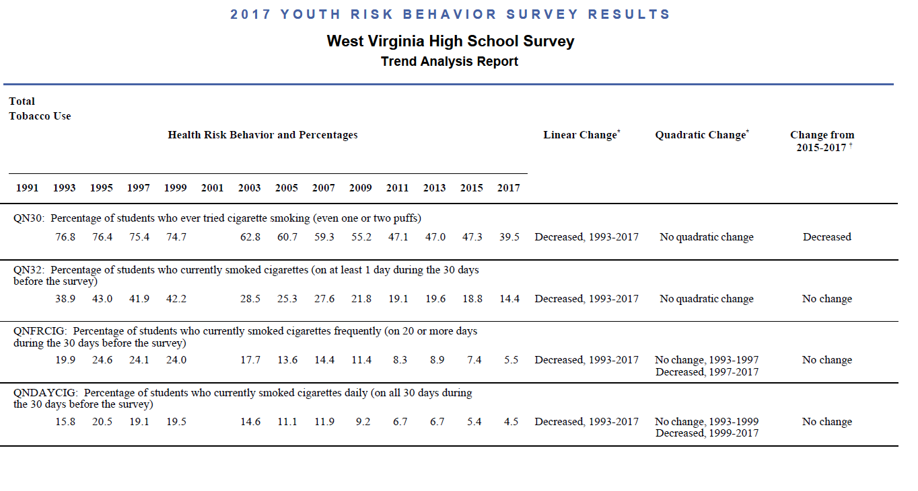

Slide 11
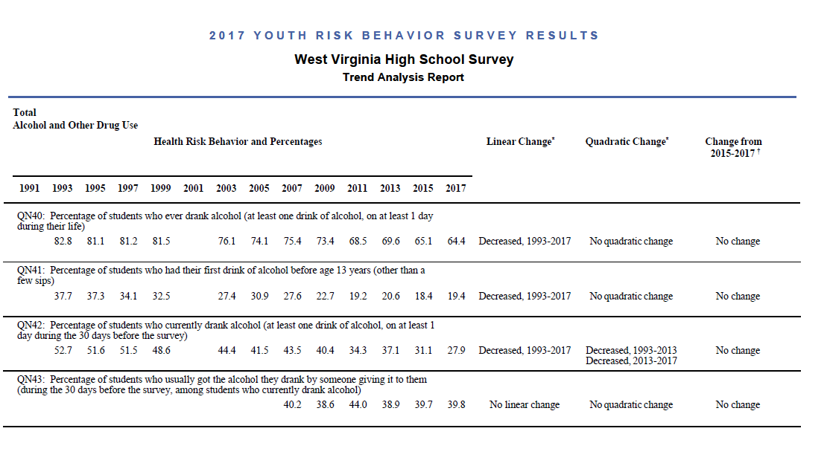

Slide 12
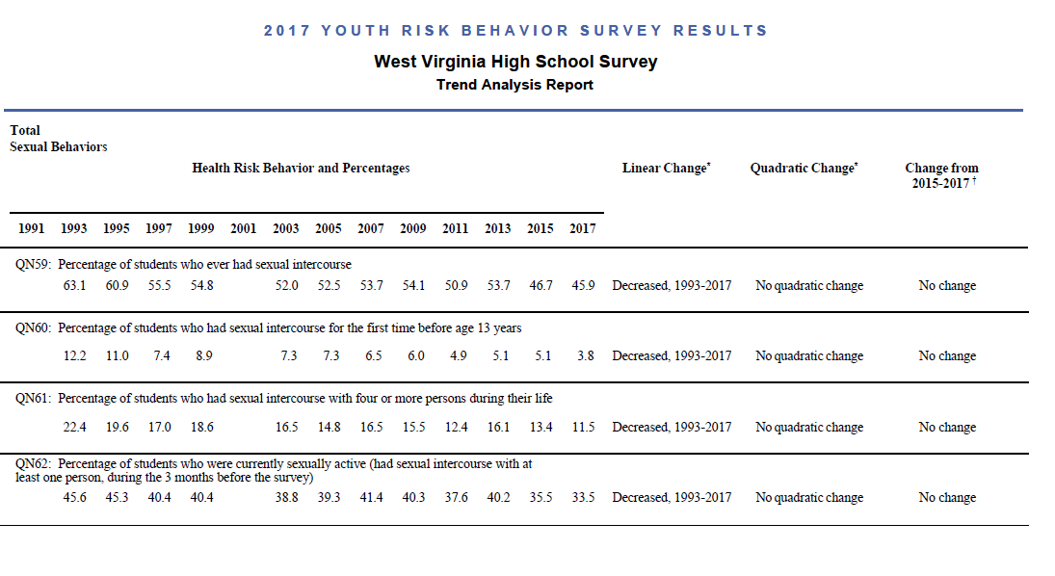

Slide 14
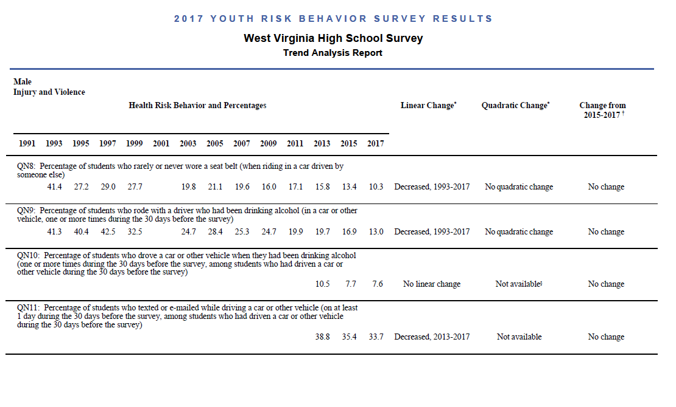

Slide 15
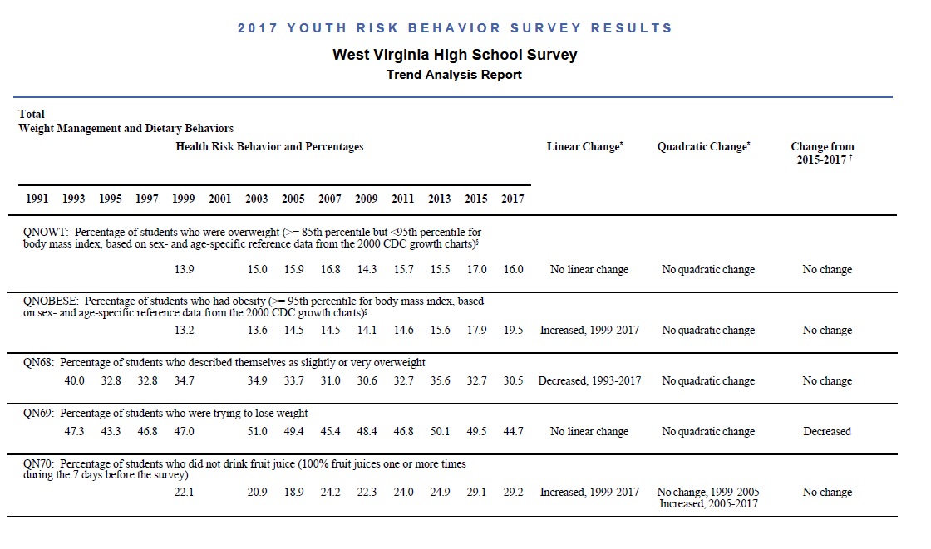

Slide 16
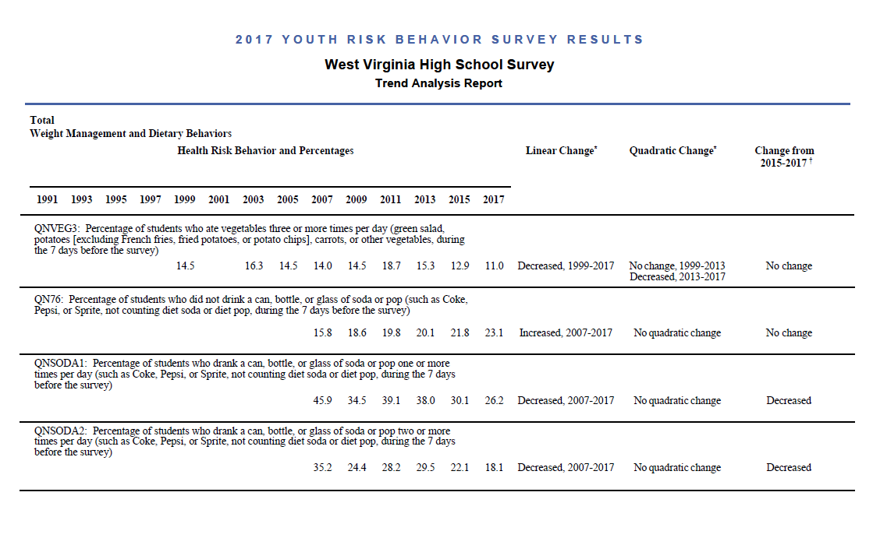

Slide 18
What diet must schools follow to trend down the statistics … A WSCC Diet

Slide 21
Josh Grant
jgrant@k12.wv.us

